Slide 1

HUD SITE VISIT; JAN. 22/23, 2020 - East Rome Crossing CHOICE NEIGHBORHOOD PLAN
VISIONING WORKSHOP
East Rome Crossing
Choice Neighborhood Plan
NWGHA and City Leaders
May 13th 2021
Visioning Presentation Prepared by:
Camiros, Ltd.; Planning Coordinator
VISION FOR THE NEIGHBORHOOD – EAST ROME CROSSING CHOICE NEIGHBORHOOD PLAN

Slide 2

INTRODUCTION TO VISIONING
In the Choice Planning Process, the goal is to transform distressed neighborhoods into neighborhoods of choice. Transforming the neighborhood involves a great deal of change on multiple levels. Managing change should be guided by a clear vision of what residents and stakeholders want the neighborhood to become. Please help frame the vision for the East Rome Crossing Neighborhood.
Framing a vision for the East Rome Crossing Neighborhood is not making the plan itself, but setting the guiding principles. Framing the vision involves the following steps:
Introduction to Visioning
Understanding the Context
Understanding Trends
Defining Aspirations
Setting Guiding Principles
Assessing Capacity
VISION FOR THE NEIGHBORHOOD – EAST ROME CROSSING CHOICE NEIGHBORHOOD PLAN

Slide 3
INTRODUCTION TO VISIONING
INTRODUCTION TO VISIONING:
Before we start discussing the first visioning component, it will be useful to provide some background on the Choice Neighborhoods Program and what some reasonable expectations are for the outcome of this planning process.
Residents should understand that, as a result of the Plan and its implementation:
Public housing, as we know it today, will cease to exist in the East Rome Crossing Neighborhood. Existing public housing properties will be demolished and existing NWGHA units will be placed mixed-income dwelling units.
Mixed-income housing is where affordable housing units are mixed with market-rate units in the same buildings.
East Rome Crossing will be a diverse neighborhood with a place for everyone who wants to be part of it, where existing residents are not displaced.
VISION FOR THE NEIGHBORHOOD – EAST ROME CROSSING CHOICE NEIGHBORHOOD PLAN

Slide 4
INTRODUCTION TO VISIONING
INTRODUCTION TO VISIONING
What are the key outcomes or results needed to transform the East Rome Crossing Neighborhood into a neighborhood of choice? The threshold metric is attracting market rate homebuyers and renters to the neighborhood. How can that be achieved?
Eliminate/mitigate the key negative attributes of the neighborhood.
Eliminate the stigma of public housing.
Achieve positive investment/development momentum.
Rebrand the neighborhood to create a positive vibe, creating a distinct idenity and attractive character.
VISION FOR THE NEIGHBORHOOD – EAST ROME CROSSING CHOICE NEIGHBORHOOD PLAN

Slide 5
INTRODUCTION TO VISIONING
INTRODUCTION TO VISIONING
Before we discuss the vision for East Rome Crossing, it would be useful to gauge whether the group thinks transformation into a neighborhood of choice is realistically possible.
Yes
No
VISION FOR THE NEIGHBORHOOD – EAST ROME CROSSING CHOICE NEIGHBORHOOD PLAN

Slide 6
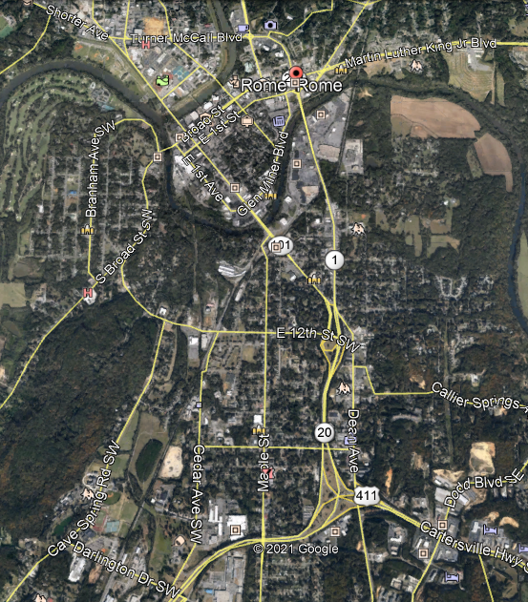
UNDERSTANDING THE CONTEXT
UNDERSTANDING THE CONTEXT
Understanding the relationship between the neighborhood and the community is important to assessing viable strategies.
Holmes Ave.
Clinton Ave.
COUNTRY CLUB
Downtown
Triana Blvd.
ROME’S NEIGHBORHOODS ARE GENERALLY SEPARATED BY RIVERS, TOPOGRAPHY, OR HIGHWAYS
Memorial Parkway
BECK’S BLUFF/WOODS
Governor’s Drive
East Rome Crossing
Inner Bypass Highway
DARLINGTON SCHOOL
Bob Wallace Drive
VISION FOR THE NEIGHBORHOOD – EAST ROME CROSSING CHOICE NEIGHBORHOOD PLAN

Slide 7
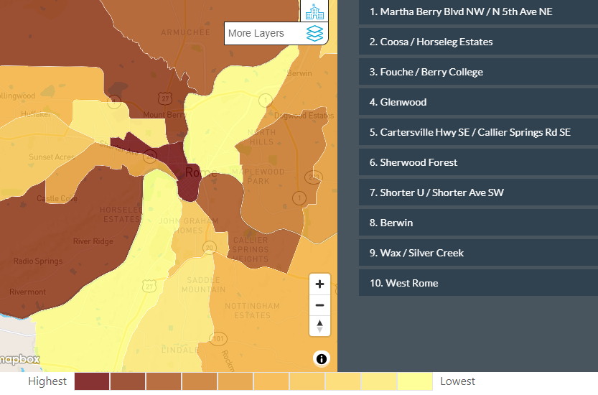
UNDERSTANDING THE CONTEXT
UNDERSTANDING THE CONTEXT
Understanding the neighborhood’s relationship to home values within the community is also important to assess prospects for attracting market-rate investment.
Clinton Ave.
Triana Blvd.
Memorial Parkway
Governor’s Drive
East Rome Crossing
Inner Bypass Highway
Color coding of home values within Rome’s neighborhoods
East Rome Crossing
Bob Wallace Drive
VISION FOR THE NEIGHBORHOOD – EAST ROME CROSSING CHOICE NEIGHBORHOOD PLAN

Slide 8
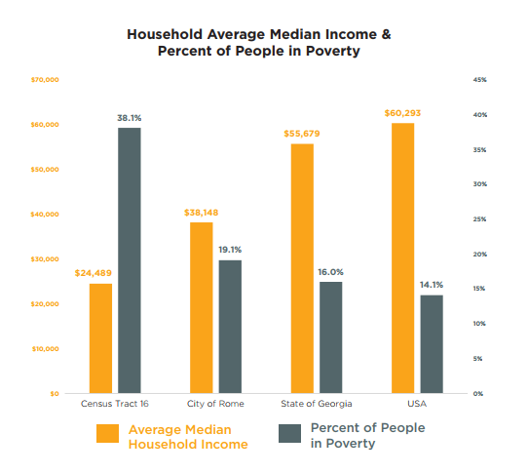
UNDERSTANDING TRENDS
1) UNDERSTANDING TRENDS
Demographic trends are moderately favorable:
Georgia is a high-growth state with major population growth
Rome and Floyd County have grown moderately
Potential exists for increased growth
Rome is projected to see job growth better than U.S. average
Anecdotal evidence suggests local wages are rising
Rome has a relatively high rate of poverty. Job and wage growth could help reduce the poverty rate.
VISION FOR THE NEIGHBORHOOD – EAST ROME CROSSING CHOICE NEIGHBORHOOD PLAN

Slide 9
UNDERSTANDING TRENDS
1) UNDERSTANDING TRENDS:
It is human nature to expect that the future will be a continuation of the past. However, with respect to the form and function of cities and neighborhoods, the future is rarely a continuation of the past. Neighborhoods in particular tend to either improve or decline over time. Sometimes change occurs so slowly that most people do not observe it. In the East Rome Crossing Neighborhood, slow but steady decline occurred for several decades. In recent years, some positive changes have occurred that could be achievements to build upon.
Recent positive changes in the East Rome Crossing neighborhood include:
Sandra Hudson Villas redevelopment
New single family and duplex development by NWGHA
Receipt of the Choice Neighborhoods Planning Grant
Pending redevelopment of the John Graham Homes site
VISION FOR THE NEIGHBORHOOD – EAST ROME CROSSING CHOICE NEIGHBORHOOD PLAN

Slide 10
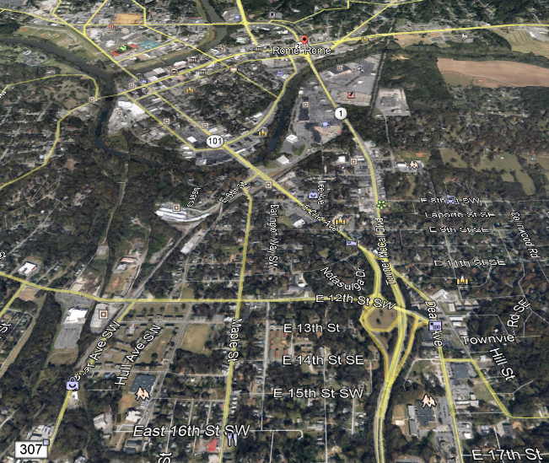
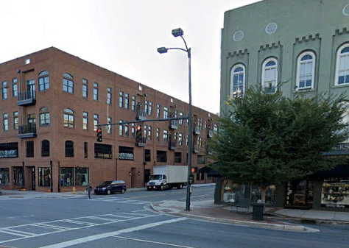
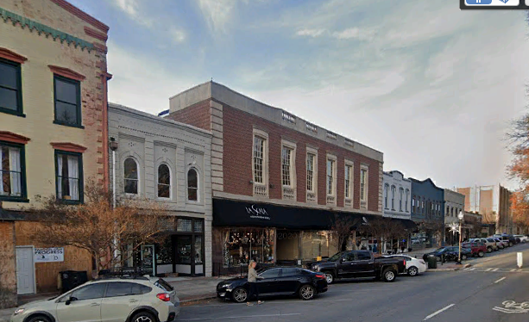
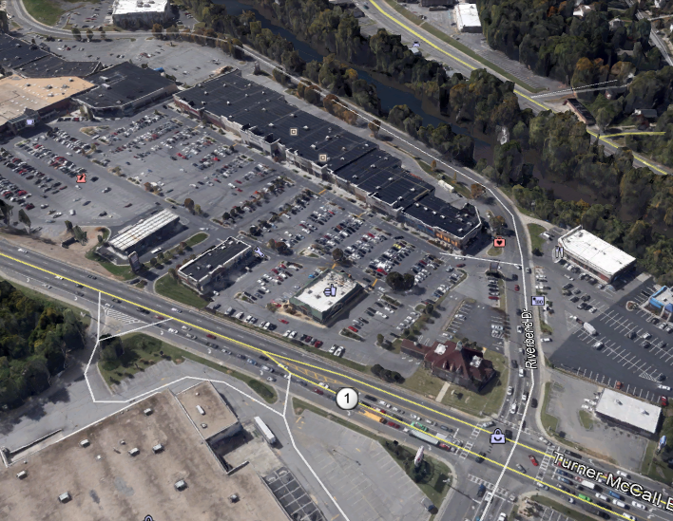
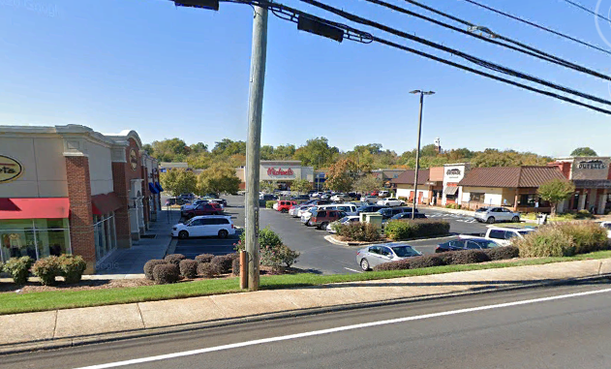
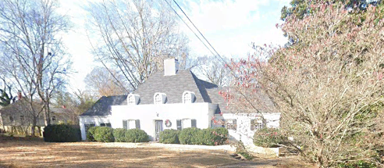
ASSESSING ASSETS AND STRENGTHS
ASSESSING ASSETS AND STRENGTHS:
Leveraging assets and areas of strength is central to improving the neighborhood. East Rome Crossing’s location relative to downtown Rome is seen as an asset.
Clinton Ave.
DOWNTOWN ROME
Triana Blvd.
RIVERBEND DEVELOPMENT
Memorial Parkway
Governor’s Drive
ETOWAH RIVER
KEY INTERSECTION
EAST ROME HISTORIC DISTRICT
Bob Wallace Drive
VISION FOR THE NEIGHBORHOOD – EAST ROME CROSSING CHOICE NEIGHBORHOOD PLAN

Slide 11
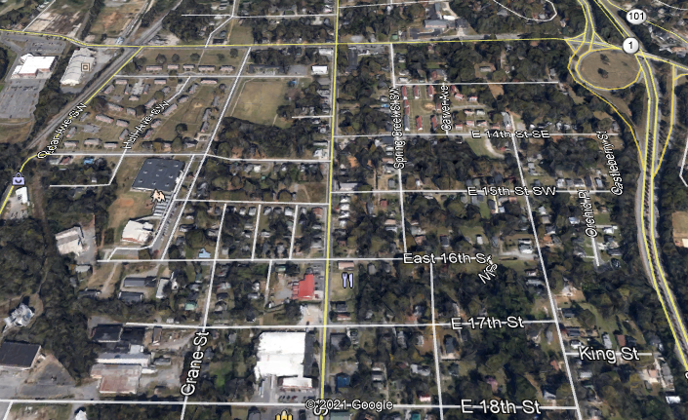
ASSESSING ASSETS AND STRENGTHS
ASSESSING ASSETS AND STRENGTHS:
Leveraging assets within the neighborhood is essential to creating a neighborhood of choice. Many of East Rome Crossing’s assets are located in the northern part of the neighborhood, towards the downtown and other nearby assets.
PROPERTY WITH POTENTIAL FOR CHANGE
Triana Blvd.
JOHN GRAHAM HOMES
FIRE DEPT.
BANTY JONES PARK
Memorial Parkway
SANDRA HUDSON VILLAS
Governor’s Drive
RESTORATION ROME
FIELDER CENTER
Bob Wallace Drive
VISION FOR THE NEIGHBORHOOD – EAST ROME CROSSING CHOICE NEIGHBORHOOD PLAN

Slide 12
ASSESSING ASSETS AND STRENGTHS
1) UNDERSTANDING TRENDS:
After this discussion of the existing context, current trends and neighborhood assets and strengths, do you now think that the East Rome Crossing Neighborhood has potential to see major improvement?
yes
no
VISION FOR THE NEIGHBORHOOD – EAST ROME CROSSING CHOICE NEIGHBORHOOD PLAN

Slide 13
DEFINING ASPIRATIONS
DEFINING ASPIRATIONS
There is a lot of latitude in formulating a plan that aligns with local sensibilities. In general terms, HUD’s guidance calls for the creation of a mixed-income neighborhood and developing successful People, Neighborhood and Housing elements. Let’s explore thoughts on the following neighborhood attributes.
Neighborhood Identity
Lifestyle
Character and Appearance
VISION FOR THE NEIGHBORHOOD – EAST ROME CROSSING CHOICE NEIGHBORHOOD PLAN

Slide 14
DEFINING ASPIRATIONS
DEFINING ASPIRATIONS
Neighborhood Identity
Which statement best reflects your thought on the desired identity of the East Rome Crossing Neighborhood:
The East Rome Neighborhood should blend seamlessly with the rest of the community and be indistinguishable from the other neighborhoods of Rome.
The East Rome Neighborhood should be a unique and special neighborhood that is unlike the other neighborhoods of Rome.
VISION FOR THE NEIGHBORHOOD – EAST ROME CROSSING CHOICE NEIGHBORHOOD PLAN

Slide 15
DEFINING ASPIRATIONS
DEFINING ASPIRATIONS
Lifestyle
Which statement best reflects your thought on the desired lifestyle of the East Rome Crossing Neighborhood:
The East Rome Crossing Neighborhood offers a different way of life than other neighborhoods because it is more self-contained having local stores, services for people, parks, and churches, all of which are easy to get to.
East Rome Crossing is distinguished from other neighborhoods by location, layout and housing stock. The lifestyle offered is similar to that of other neighborhoods.
VISION FOR THE NEIGHBORHOOD – EAST ROME CROSSING CHOICE NEIGHBORHOOD PLAN

Slide 16
DEFINING ASPIRATIONS
DEFINING ASPIRATIONS
Character and Appearance
Which statement best reflects your thoughts on the desired character and appearance of the East Rome Crossing Neighborhood:
The East Rome Crossing Neighborhood offers similar character and appearance to other neighborhoods in Rome.
East Rome Crossing has a special character, combining traditional small-town character with innovative urban design and architectural themes.
VISION FOR THE NEIGHBORHOOD – EAST ROME CROSSING CHOICE NEIGHBORHOOD PLAN

Slide 17
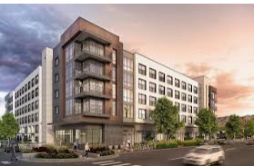
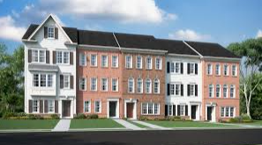
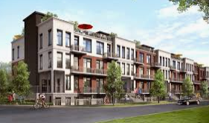
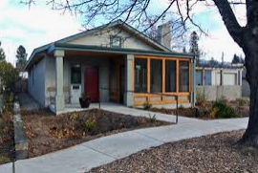
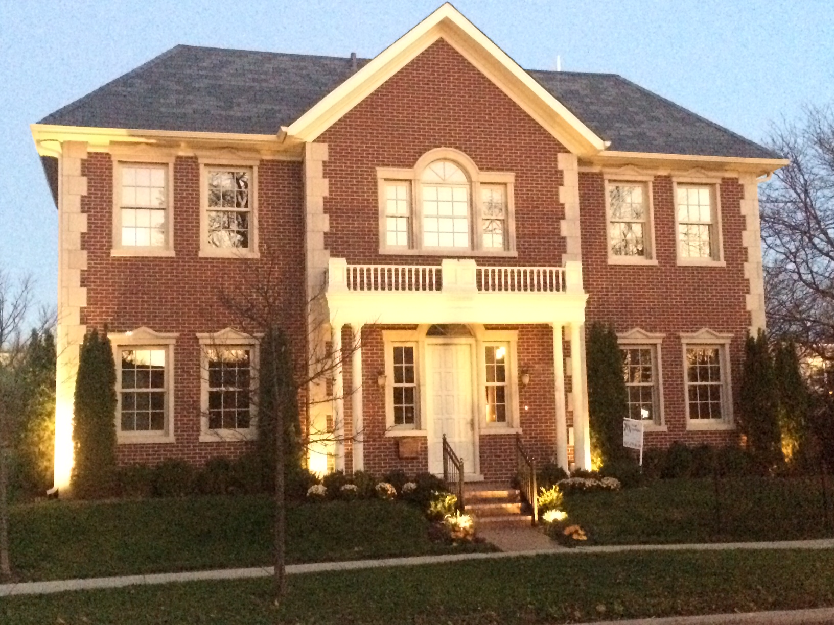
VISION FOR THE NEIGHBORHOOD – EAST ROME CROSSING CHOICE NEIGHBORHOOD PLAN
GUIDING PRINCIPLES
GAUGING IMPROVEMENT POTENTIAL
Creating a neighborhood of choice involves providing a range of housing types and levels of affordability, including rental and for-sale housing. Visioning should address both the redevelopment of public housing sites into mixed income developments as well as new private development.
A
What types of new housing do you think belong in the East Rome Crossing Neighborhood? (select all that apply; do not focus on architectural style)
Mid/High Rise Apartment (4+ stories)
Townhomes
Upscale Single-Family
Affordable Single-Family/Duplex
Low-Rise Apartments (3 Stories)
None of these examples
MID/HIGH-RISE APARTMENTS
B
TRIANA BLVD
TOWNHOMES
E
D
C
BOB WALLACE DR.
LOW-RISE APARTMENTS
AFFORDABLE SINGLE FAMILY/DUPLEX
UPSCALE SINGLE FAMILY

Slide 18
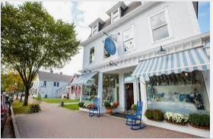
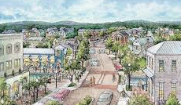
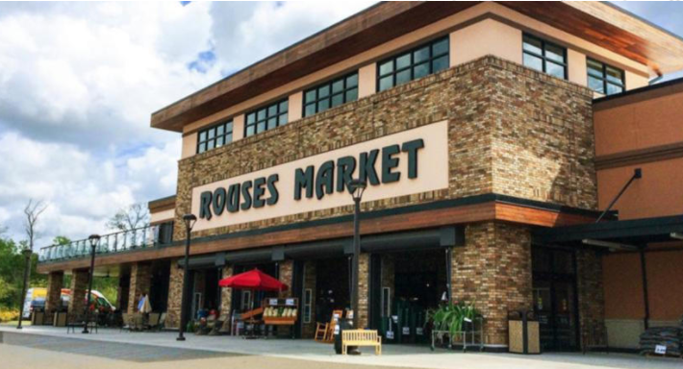
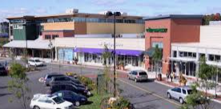
VISION FOR THE NEIGHBORHOOD - East Rome Crossing CHOICE NEIGHBORHOOD PLAN
GUIDING PRINCIPLES
GAUGING IMPROVEMENT POTENTIAL
Creating a neighborhood of choice involves much more than just new housing. Shopping and services are a key part of neighborhood of choice, particularly since East Rome Crossing is somewhat isolated and lacks retail uses.
A
Recognizing that market demand for retail uses is small, which images align with your vision for retail development for the neighborhood? (select all that apply)
Small neighborhood store
New urbanist cluster of small stores
Small shopping plaza
Neighborhood scale grocery store
None of these examples
B
TRIANA BLVD
D
C
BOB WALLACE DR.

Slide 19

VISION FOR THE NEIGHBORHOOD - East Rome Crossing CHOICE NEIGHBORHOOD PLAN
GUIDING PRINCIPLES
GAUGING IMPROVEMENT POTENTIAL
Where do you think new shopping would be most successful? (choose all that apply.
A.
12th STREET
MAPLE AVENUE
B.
12TH Street
Maple Avenue, North
Middle Intersection
Maple Avenue, South
C.
MIDDLE INTERSECTION
D.
MAPLE AVENUE
BOB WALLACE DR.

Slide 20
VISION FOR THE NEIGHBORHOOD - East Rome Crossing CHOICE NEIGHBORHOOD PLAN
GUIDING PRINCIPLES
NEIGHBORHOOD & PEOPLE POLICIES
Effective People Policies are important to Choice Neighborhoods because there are a lot of residents with special needs. Please select two of following social service programs you think are most important:
Neighborhood health clinic
Early childhood education facility
Neighborhood public safety program
After school/summer programs for teens
Adult education/job training
No Opinion/None of the Above
CLINTON STREET
B.
D.
GOVERNOR’S DRIVE

Slide 21
VISION FOR THE NEIGHBORHOOD - East Rome Crossing CHOICE NEIGHBORHOOD PLAN
GUIDING PRINCIPLES
SETTING GUIDING PRINCIPLES
Visioning is not making the Plan but defining aspirations for the future neighborhood as we would like it to be. Setting guiding principles for the Plan helps to do this.
What phrase best describes your vision of what the East Rome Crossing Neighborhood can become. (pick one statement only)
The Neighborhood is the neighborhood of choice for people who want to live in a place where support services help all residents achieve their goals.
The Neighborhood is an attractive place of mixed uses where people of all incomes and backgrounds blend together seamlessly.
The Neighborhood successfully merges traditional small town character with new, innovative housing design along with a retail cluster to create the most interesting and most active neighborhood in Rome.

Slide 22
VISION FOR THE NEIGHBORHOOD - East Rome Crossing CHOICE NEIGHBORHOOD PLAN
GUIDING PRINCIPLES
SETTING GUIDING PRINCIPLES
Which statement best describes your position on the amount of affordable housing the Plan should provide. (pick one statement only)
The Plan should provide only the affordable housing needed to replace NWGHA units currently in the neighborhood.
The neighborhood has too much affordable housing already. NWGHA should offer vouchers to current resident of NWGHA units, which would likely reduce the number of affordable housing units needed below the number of current NWGHA units.
The Plan should program a number of affordable units equal to the number of low/moderate income households as recorded by the most recent U.S. Census figures.
I have no opinion on affordable housing.

Slide 23
VISION FOR THE NEIGHBORHOOD - East Rome Crossing CHOICE NEIGHBORHOOD PLAN
ASSESSING CAPACITY
SETTING GUIDING PRINCIPLES
Transforming the East Rome Crossing Neighborhood will need to be accomplished through local capacity. Securing a HUD implementation grant is unlikely. The local stakeholders who need to play a part in the transformation include:
The City of Rome
The NWGHA
Habitat for Humanity
Rome City Schools
Rome/Floyd County Parks
Restoration Rome
Local Homebuilders
Commercial Developers
East Rome Crossing Residents & Neighbors
Each of these stakeholders will need to expand their efforts in a coordinated way to realize transformation, as discussed further.

Slide 24
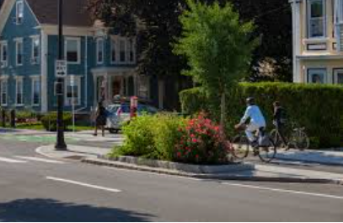
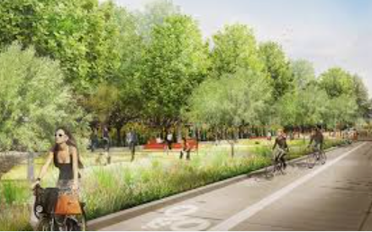
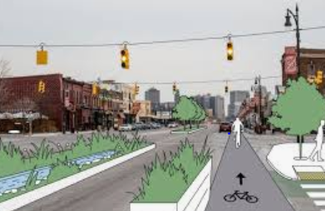
VISION FOR THE NEIGHBORHOOD - East Rome Crossing CHOICE NEIGHBORHOOD PLAN
ASSESSING CAPACITY
SETTING GUIDING PRINCIPLES
The City of Rome has the greatest jurisdiction over the neighborhood, and therefore, the most capacity. Expanded City efforts on behalf of the East Rome Crossing could include:
Strategically targeted infrastructure improvements in streets, lighting, and streetscape to help attract private-sector investment.
Consider establishing a tax allocation district for the neighborhood.
Consider improving Maple Avenue to create a special character, perhaps a multi-modal facility.
Channeling investment/energy/attention to improving the East Rome Historic District.
Investigate establishing/supporting a homeowner equity protection program for the neighborhood.
Should the City seriously consider taking action on some of all of these initiatives?
A. Yes B. No

Slide 25
VISION FOR THE NEIGHBORHOOD - East Rome Crossing CHOICE NEIGHBORHOOD PLAN
ASSESSING CAPACITY
SETTING GUIDING PRINCIPLES
The NWGHA has the most capacity to influence housing in the neighborhood, one of the three “pillars” of the Choice Planning Program. Expanded NWGHA efforts on behalf of the East Rome Crossing could include:
NWGHA has shown the ability to develop high quality housing at below market prices and should expand its reach in terms of housing types and people served.
Align its design standards to reinforce existing and desired neighborhood character.
Expand the number of homes built for for non-public housing residents, including those in the 80%-120% AMI income range.
Expand housing development into the for-sale sector, which is likely limited to households under 120% AMI.
Consider rehabbing existing single-family homes for affordable rentals or for-sale units.
Should the NWGHA seriously consider taking action on some of all of these initiatives?
A. Yes B. No

Slide 26
VISION FOR THE NEIGHBORHOOD - East Rome Crossing CHOICE NEIGHBORHOOD PLAN
ASSESSING CAPACITY
SETTING GUIDING PRINCIPLES
Some potential initiatives for other stakeholders are listed below.
Habitat for Humanity; producing quality homes at below market prices is critical in the early stages of transformation; expand number of homes built per year; target new homes to align with East Rome Crossing transformation.
Rome City Schools; ensure that students living in East Rome Crossing achieve academic achievement on par with other schools in other neighborhoods.
Rome/Floyd County Parks; turn Banty Jones Park into a premier park.
Restoration Rome; provide a local health clinic available for all residents.
Local Homebuilders; convince them to build custom home or spec home, when conditions are right.
Commercial Developers; build attractive retail.
East Rome Crossing Residents & Neighbors; form a neighborhood association to organize residents to support improvement efforts.
Is it reasonable to expect these stakeholders to take action on some or all of these initiatives?
A. Yes B. No

Slide 27
HUD SITE VISIT; JAN. 22/23, 2020 - East Rome Crossing CHOICE NEIGHBORHOOD PLAN
Thank you for helping frame the vision for the East Rome Crossing Neighborhood!
VISIONING WORKSHOP
East Rome Crossing
Choice Neighborhoods Plan
NWGHA and City Leaders
May 13th 2021
Visioning Presentation Prepared by:
Camiros, Ltd.; Planning Coordinator
VISION FOR THE NEIGHBORHOOD - East Rome Crossing CHOICE NEIGHBORHOOD PLAN

